Slide 1
DBMS

Slide 2
INTRODUCTION
Data
  raw facts and figures
Data Processing
  performing operations on the input data to generate output.

Slide 3
Data are logically organized into:
1. Bits (characters)
2. Fields
3. Records
4. Files
5. Databases

Slide 4
What is Database?
Database is a computer based record keeping system which is used to record ,maintain and retrieve data. It is an organized collection of interrelated data.

Slide 5
What is Database Management System (DBMS)?
Collection of interrelated data
Set of programs to access the data
It provides a convenient and efficient way to store, retrieve and modify information.
Application programs request DBMS to retrieve, modify/insert/delete data for them and thus it acts as a layer of abstraction between the application programs and the file system.

Slide 6
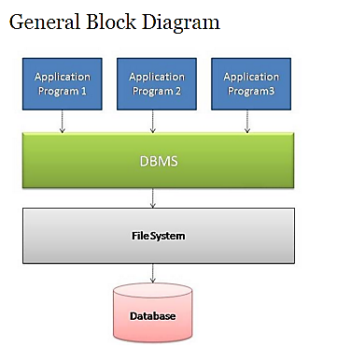

Slide 7
DATABASE APPLICATIONS:
  Banking: all transactions
  Airlines: reservations, schedules
  Universities: registration, grades
  Sales: customers, products, purchases
  Online retailers: order tracking, customized recommendations
  Manufacturing: production, inventory, orders, supply chain
  Human resources: employee records, salaries, tax deductions

Slide 8
Purpose of Database Systems
Need for Database systems arose in response to early methods of computerized management of commercial data.
One way to keep the information on a computer is to store it in operating system files.
To allow users to manipulate the information like
  Add new students, instructors and courses.
  Assign grades to students, compute grade point averages (GPA), and generate transcripts
  In the early days, database applications were built directly on top of file systems

Slide 9
Purpose of Database Systems
Drawbacks of using file systems to store data:
  Data redundancy (repetition of information)
  Data Inconsistency (Multiple copies of same data not updated)
  Difficulty in accessing data
    We should know the physical details of the file before accessing (like Location, Name, Permissions, File Format, etc.)
  Data isolation — multiple files and schema
  Integrity problems are there in traditional file system.
  Searching is difficult – No Index to the records.
Notes:
Data Isolation: Since the data files are created at different times and supposedly by different people the structures of different files generally will not match. The data will be scattered in different files for a particular entity. So it will be difficult to obtain appropriate data.
Suppose the Address in Saving Account file have fields: Add line1, Add line2, City, State, Pin while the fields in address of Current account are: House No., Street No., Locality, City, State, Pin. Administrator is asked to provide the list of customers living in a particular locality. Providing consolidated list of all the customers will require looking in both files.
Integrity Problems: All the consistency constraints have to be applied to database through appropriate checks in the coded programs. This is very difficult when number such constraint is very large.
For example: An account should not have balance less than Rs. 500. To enforce this constraint appropriate check should be added in the program which add a record and the program which withdraw from an account. Suppose later on this amount limit is increased then all those check should be updated to avoid inconsistency. These time to time changes in the programs will be great headache for the administrator.

Slide 10
Purpose of Database Systems (Cont.)
Drawbacks of using file systems (cont.)
  Concurrent access by multiple users
    Concurrent accessed needed for performance.
    Uncontrolled concurrent accesses can lead to inconsistencies
      Example: Two people reading a balance and updating it at the same time.
  Security problems
    Hard to provide user access to some, but not all, data.
Database systems offer solutions to all the above problems

Slide 11
Components of DBMS
The DBMS software is partitioned into several modules. Each module or component is assigned a specific operation to perform.
Some of the functions of the DBMS are supported by operating systems (OS) to provide basic services.
The physical data and system catalog are stored on a physical disk. Access to the disk is controlled primarily by OS.
The major software modules or components of DBMS are as follows:
  Query processor
  Run time database manager
  Data Manager

Slide 12
Query Processor
It is used to interpret the online user query and converts into a form capable of being send to the data manager for execution.
The query processor use the data dictionary to find the structure of a database.
It is a program module that provides the interface between the database and the application programs/queries.
The Query Processor Components include –
  Data Definition Language(DDL) Compiler(Create, Alter[Add, Drop, Modify], Drop, Describe)
  Data Manipulation Language (DML) compiler(Insert, Update, Select)
  Query evaluation engine

Slide 13
Data Dictionary
A data dictionary is a reserved space within a database which is used to store information about the database itself.
A data dictionary is a set of table and views which can only be read and never altered.
The data dictionary also defines how much space has been allocated for and / or currently in used by all the schema objects.
A data dictionary is used when finding information about users, objects, schema and storage structures.
Every time a data definition language (DDL) statement is issued, the data dictionary becomes modified.

Slide 14
Data Dictionary
A data dictionary may contain information such as:
Database design information
Stored SQL procedures
User permissions
User statistics
Database process information
Database growth statistics
Database performance statistics

Slide 15
Runtime Database Manager
Run time database manager is the central software component of the DBMS.
It handles database access at run time.
It accepts queries and examines the external and conceptual schemas to determine what conceptual records are required to satisfy the user’s request.
It enforces constraints to maintain the consistency and integrity of the data, as well as its security.
It also performs backing and recovery operations.

Slide 16
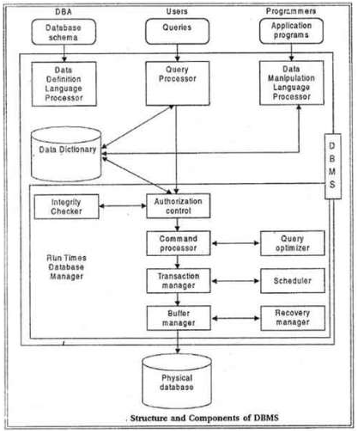

Slide 17
Runtime Database Manager
It has following components:
  Authorization control
  Command processor
  Integrity checker
  Query optimizer
  Transaction manager
  Scheduler

Slide 18
Runtime Database Manager
Authorization control: The authorization control module checks the authorization of users in terms of various privileges to users.
Command processor: The command processor processes the queries passed by authorization control module.
Integrity checker: It .checks the integrity constraints so that only valid data can be entered into the database.
Query optimizer: The query optimizers determine an optimal strategy for the query execution.
Transaction manager: The transaction manager ensures that the transaction properties should be maintained by the system.
Scheduler: It provides an environment in which multiple users can work on same piece of data at the same time in other words it supports concurrency.

Slide 19
Data Manager
The data manager is responsible for the actual handling of data in the database.
It provides recovery to the system which that system should be able to recover the data after some failure.
It includes Recovery manager and Buffer manager.
The buffer manager is responsible for the transfer of data between the main memory and secondary storage (such as disk or tape). It is also referred as the cache manger.

Slide 20
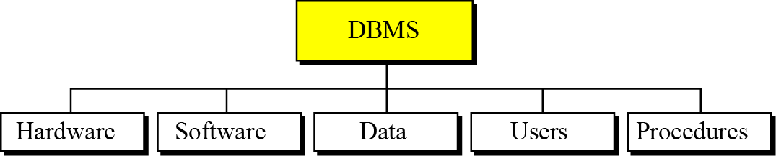
Components of DBMS Environment
A database management system (DBMS) defines, creates and maintains a database.
A DBMS is a combination of five components: hardware, software, data, users and procedures.

Slide 21
DBMS Environment Components
Software
  The software is the actual program that allows users to access, maintain and update data.
  In addition, the software controls which user can access which parts of the data in the database.
Hardware
  Hardware consists of a set of physical electronic devices such as computers, storage devices, I/O channels, electromechanical devices that make interface between computers and the real world systems etc, and so on.
  It is impossible to implement the DBMS without the hardware devices.

Slide 22
DBMS Components
Data
  Data is the most important component of the DBMS. The main purpose of DBMS is to process the data.
  In DBMS, databases are defined, constructed and then data is stored, updated and retrieved to and from the databases.
  The database contains both the actual (or operational) data and the metadata (data about data or description about data).

Slide 23
DBMS Components
User
  The users are the people who manage the databases and perform different operations on the databases in the database system. There are three kinds of people who play different roles in database system:
    Application Programmers
    Database Administrators.
    End-Users.
Procedures
  The last component of a DBMS is a set of procedures or rules that should be clearly defined and followed by the users of the database.
Notes:
Database administrators (DBA) are responsible for: Authorizing access to the database, Coordinating and monitoring its use, Acquiring software and hardware resources
Database designers are responsible for: Identifying the data to be stored, Choosing appropriate structures to represent and store this data.
End users: People whose jobs require access to the database ▪ Types • Casual end users • Naive or parametric end users • Sophisticated end users • Standalone users

Slide 24
INSTANCE & SCHEMA
Databases change over time as information is inserted and deleted.
The collection of information stored in the database at a particular moment is called an instance of the database.
The overall design of the database is called the database schema.
Database systems have several schemas, partitioned according to the levels of abstraction.
The physical schema describes the database design at the physical level, while the logical schema describes the database design at the logical level.

Slide 25
THREE LEVEL DATABASE ARCHITECTURE
Data are actually stored as bits, or numbers and strings, but it is difficult to work with data at this level.
It is necessary to view data at different levels of abstraction.
  Physical Data Level
  Conceptual Data Level
  External Data Level/View Level.

Slide 26
THREE LEVEL DATABASE ARCHITECTURE
View Level
What data users and application programs see ?
…
View 1
View 2
View n
Logical / Conceptual
Level
What data is stored ?
describe data properties such as
data semantics, data relationships
Physical
Level
How data is actually stored ?
e.g. are we using disks ? Which
file system ?

Slide 27
Physical Level in Database Architecture
Knows how data is physically stored into the database. It knows the File Format, Record Format, Index of file, Location of file, etc.
It also typically describes the record layout of files and type of files (hash, b-tree, flat).
Early applications worked at this level - explicitly dealt with details.
Problems:
  Changes to data structures are difficult to make.
  Application code becomes complex since it must deal with details.
  Rapid implementation of new features very difficult.
  Routines are hardcoded to deal with physical representation.

Slide 28
Conceptual Level in Database Architecture
The next-higher level of abstraction describes what data are
stored in the database, and what relationships exist among those data.
Also referred to as the Logical level.
Hides details of the physical level.
The DBMS maps data access between the conceptual to physical schemas automatically.
Represents:
  entities, attributes, relations
  constraints on data
  semantic information on data
  security, integrity information

Slide 29
View Level in Database Architecture
The highest level of abstraction describes only part of the entire database.
The user’s view of the database.
Consists of a number of different external views of the DB.
Provides a powerful and flexible security mechanism by hiding parts of the DB from certain users. The user is not aware of the existence of any attributes that are missing from the view.
Examples:
  Students should not see faculty salaries.
  Faculty should not see billing or payment data.

Slide 30
Data Independence

Slide 31
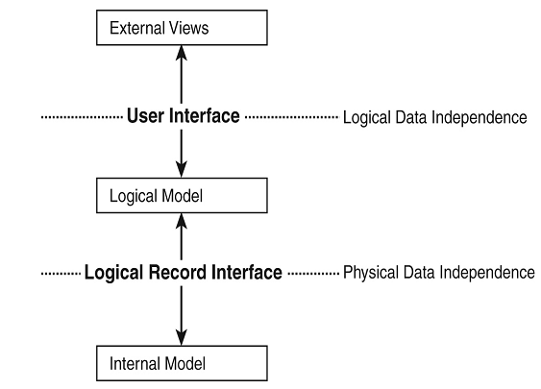
Data Independence
The ability to modify the schema definition in one level should not affect the schema definition in the next higher level.
Two types of Data Independence:
  Physical
  Logical

Slide 32
Logical Data Independence

Slide 33
What do you mean by logical data independence?
The ability to change the logical schema without changing the external schema or application programs is called as Logical Data Independence.
OR
The ability to change the logical schema without having to change the external schema.

Slide 34
Examples
The name field in conceptual view is stored as first name, middle name and last name whereas in external view, it remains to be as a single name field.

Slide 35
Physical Data Independence

Slide 36
What do you mean by Physical Data Independence?
The ability to change the physical schema without changing the logical schema is called as Physical Data Independence.
Modifications at this level are usually to improve performance
Changes in the physical schema may include.
  Using new storage devices.
  Using different data structures.
  Switching from one access method to another.
  Using different file organizations or storage structures.
  Modifying indexes.

Slide 37
Data Models
A database model defines the logical design of data. The model also describes the relationships between different parts of the data. In the history of database design, three models have been in use: the hierarchical model, the network model and the relational model.

Slide 38
Data Models
A model is a representation of reality, ‘real world’ objects and events and their associations.
A model is a collection of tools for describing
  Data
  Data relationships
  Data semantics
  Data constraints
Various models falls into three different categories:
  Object-based data models
  Record Based Data Models
  Physical Data Models

Slide 39
Object Based Data Models
Use the concept of entities, attributes and relationships.
Used to describe data at the logical and view level.
It provides flexible structuring capabilities.
The most widely known ones are:
  The Entity-Relationship Model
  The Object-Oriented Model.

Slide 40
Entity-Relationship Model
It consists of basic objects called “Entities”, and “Relationships” among these objects.
An entity is a thing or object in the real world that is distinguishable from other objects.
Entities are described by set of attributes.
Entities are the principal data object about which info is to be collected.
A relationship is association among several entities.

Slide 41
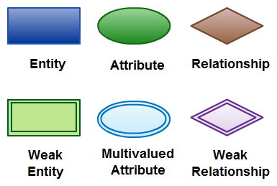
Entity-Relationship Model
Basic constructs of ER Model
  Entities
  Entity set (Set of entities of same type that share the same properties)
  Relationships
  Attributes (Describe the properties of entity)
    Simple Attribute
    Compound/Composite Attribute
    Derived Attribute
    Multivalued Attribute
  Degree of relationship
    No. of entities associated with the relationship (n-ary)
  Cardinality (Mapping)

Slide 42
Entity-Relationship Model (Cardinality)
One to one cardinality (One student has one Address/Contact No.)
One to many cardinality (One student registered in many courses)
(A department has many employees)
Many to one cardinality (Many employees are working in one dept.)
Many to Many cardinality (Employees can be assigned to more than two projects at a time)

Slide 43
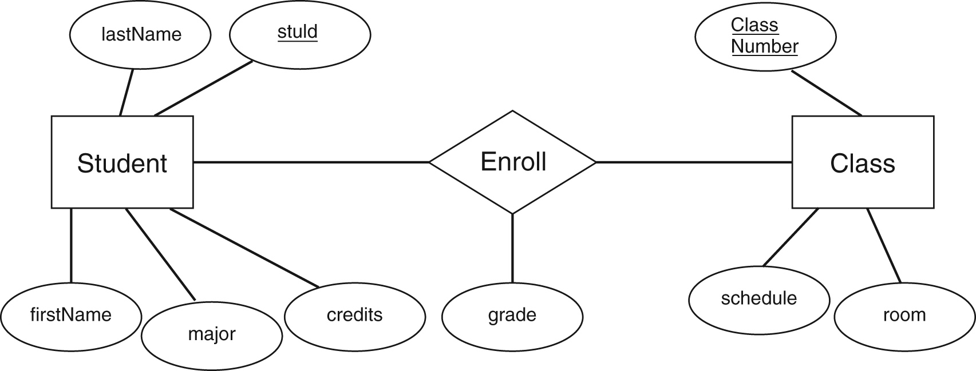
Entity-Relationship Model

Slide 44
Object Oriented Data Model
Objects that contains the same types of values and the same methods are grouped together into classes.
Like ER model OODM is based on collection of objects.
Object contains values stored in instance variable within the object.

Slide 45
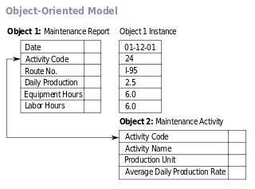

Object Oriented Model

Slide 46
Record Based Data Models
It is used to describe data at the logical and view level.
Record based models are so named because the database is structured in fixed format records of several types.
  Relational Model
  Network Model
  Hierarchal Model

Slide 47
Relational Model
Relational data model is the primary data model, which is used widely around the world for data storage and processing.
It stores data in the form of tables.
This concept was proposed by E.F. Codd, a researcher of IBM in year 1960s.
It uses a collection of tables to represent both data and relationship among the data.
Each table has multiple columns and each column has unique name.

Slide 48
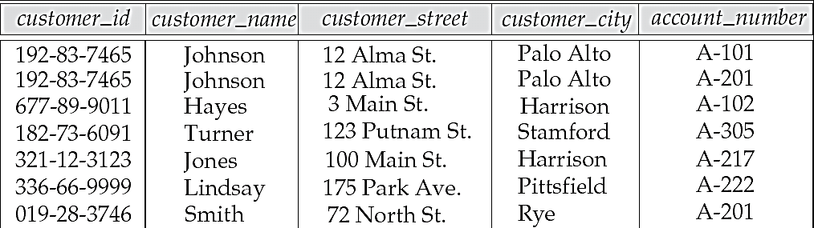
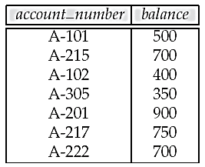
Relational Model

Slide 49
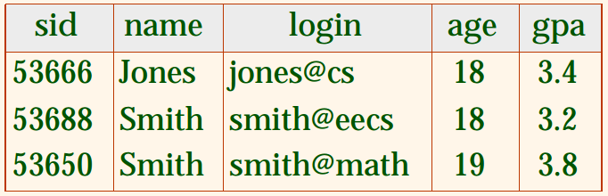
Basic Terminology used in Relational Model
Tuple of a relation (Each row is called a tuple)
Cardinality of a relation (No. of tuples in a relation)
Degree of a relation (No. of attributes in a relation)
Domain (Set of all possible values that an attribute my validly contain)

Slide 50
Hierarchical database model
Organizes data in a tree structure (parent and child data).
Each entity has only one parent but can have several children.
At the top of the hierarchy, there is one entity, which is called the root.
1:N mapping between record types.

Slide 51
Hierarchical database model
Advantages:
  Simplicity (Conceptually Simple)
  Data security
  Data Integrity
  Efficiency (Speed of access is faster because of the predefined data paths)
Disadvantages:
  implement complexity
  database management problem
  programming complexity
  implementation limitation
Notes:
Advantages:
Simplicity: Relationship between the various layers is logically simple. Thus design of a database is simple.
Data Integrity: Based on Parent/Child relationship. The child segments are always automatically referred by its parent, so this model promotes integrity.
Disadvantages:
Implementation Complexity: Although the hierarchal database model is conceptually simple and easy to design, it is quite complex to implement. The database designers should have very good knowledge of physical data storage.
Database management problem: Any change in database structure then u need to make the necessary changes in all the application programs that access the database.
Programming complexity: Due to the structural dependence, the end user must know precisely how the data is distributed physically in the database in order to access data.
Implementation Limitation: Many to many relationships are more common in real life but difficult to implement in a hierarchal model.

Slide 52
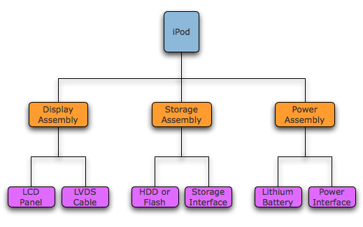
Hierarchical Database Model

Slide 53
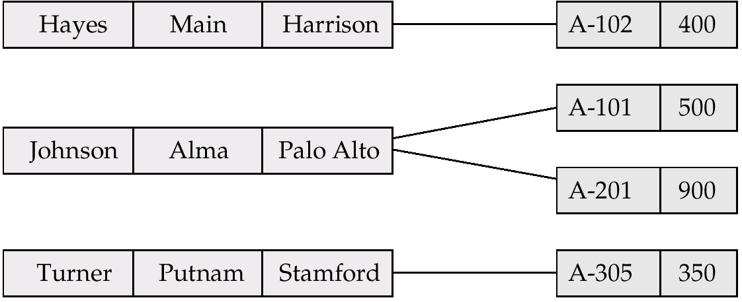
Network database model
In the network model, the entities are organized in a graph, in which some entities can be accessed through several paths.
Some data modeled with more than one parent per child.
Permits modeling of many-to-many relationships in data.
It is represented by collection of records and relationship among data is represented by links..

Slide 54
Network database model
Advantages:
  Easy to access data
  Can handle more relationship types
  Conceptually simple
  Data Integrity
Disadvantages
  System complexity (Pointers)
  Operational Anomalies (Change in any record require large number of pointers adjustments)
  Absence of structural independence.

Slide 55
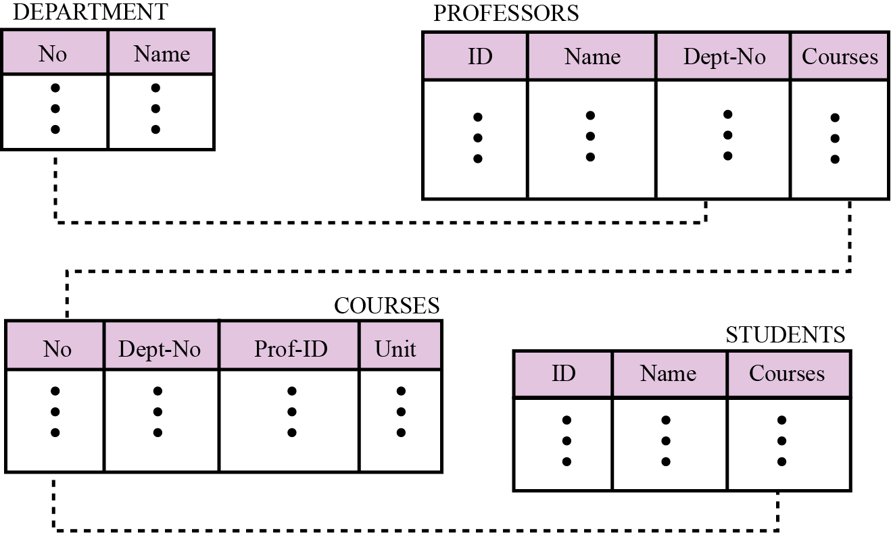
Relational database model
In the relational model, data is organized in two-dimensional tables called relations.

Slide 56
Database Languages
DDL
DML
DCL

Slide 57
Database Constraint

Slide 58
Introduction
Constraints are the rules enforced on data columns on table. These are used to limit the type of data that can go into a table. This ensures the accuracy and reliability of the data in the database.
Constraints could be column level or table level.
Column level constraints are applied only to one column, whereas table level constraints are applied to the whole table.

Slide 59
Types of Constraints
Following are commonly used constraints available in SQL:
  NOT NULL Constraint: Ensures that a column cannot have NULL value.
  DEFAULT Constraint: Provides a default value for a column when none is specified.
  UNIQUE Constraint: Ensures that all values in a column are different. It can be a NULLL.
  PRIMARY Key: Uniquely identified each rows/records in a database table.
  FOREIGN Key: Uniquely identified a rows/records in any another database table.
  CHECK Constraint: The CHECK constraint ensures that all values in a column satisfy certain conditions.

Slide 60
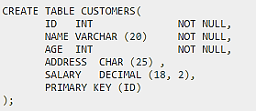
NULL Value Constraint
By default, a column can hold NULL values. If you do not want a column to have a NULL value, then you need to define such constraint on this column specifying that NULL is now not allowed for that column.
A NULL is not the same as no data, rather, it represents unknown data.

Slide 61
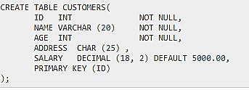
DEFAULT constraint
The DEFAULT constraint provides a default value to a column when the INSERT INTO statement does not provide a specific value.

Slide 62
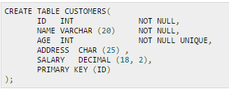
UNIQUE constraint
The UNIQUE Constraint prevents two records from having identical values in a particular column. In the CUSTOMERS table, for example, you might want to prevent two or more people from having identical age.
If CUSTOMERS table has already been created, then to add a UNIQUE constraint to AGE column, you would write a statement similar to the following:
ALTER TABLE CUSTOMERS MODIFY AGE INT NOT NULL UNIQUE;

Slide 63
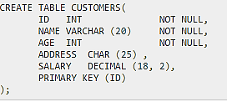
PRIMARY Constraints
A primary key is a field in a table which uniquely identifies each row/record in a database table. Primary keys must contain unique values. A primary key column cannot have NULL values.
A table can have only one primary key, which may consist of single or multiple fields. When multiple fields are used as a primary key, they are called a composite key.
If a table has a primary key defined on any field(s), then you can not have two records having the same value of that field(s).

Slide 64
Foreign Key Constraint
A foreign key is a key used to link two tables together. This is sometimes called a referencing key.
Foreign Key is a column or a combination of columns whose values match a Primary Key in a different table.
The relationship between 2 tables matches the Primary Key in one of the tables with a Foreign Key in the second table.

Slide 65
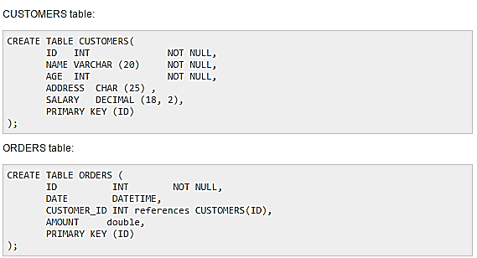
Foreign Key Constraint

Slide 66
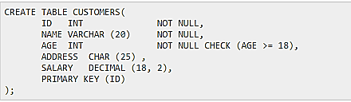
CHECK Constraint
The CHECK Constraint enables a condition to check the value being entered into a record. If the condition evaluates to false, the record violates the constraint and isn't entered into the table.

